Slide 1
Case Studies- Continue from Ch1
Dr. Lo’ai Tawalbeh

Slide 2
Case studies
A personal insulin pump
  An embedded system in an insulin pump used by diabetics to maintain blood glucose control.
A mental health case patient management system
  Mentcare. A system used to maintain records of people receiving care for mental health problems.
A wilderness weather station
  A data collection system that collects data about weather conditions in remote areas.
iLearn: a digital learning environment
  A system to support learning in schools

Slide 3
Insulin pump control system
Collects data from a blood sugar sensor and calculates the amount of insulin required to be injected.
Calculation based on the rate of change of blood sugar levels.
Sends signals to a micro-pump to deliver the correct dose of insulin.
Safety-critical system as low blood sugars can lead to brain malfunctioning, coma and death; high-blood sugar levels have long-term consequences such as eye and kidney damage.

Slide 4
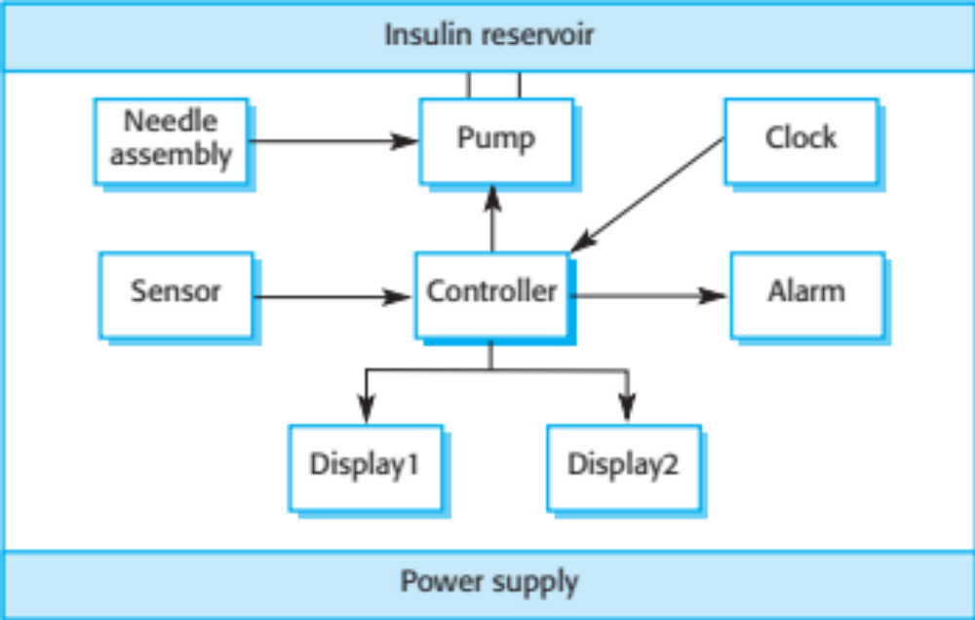
Insulin pump hardware architecture

Slide 5
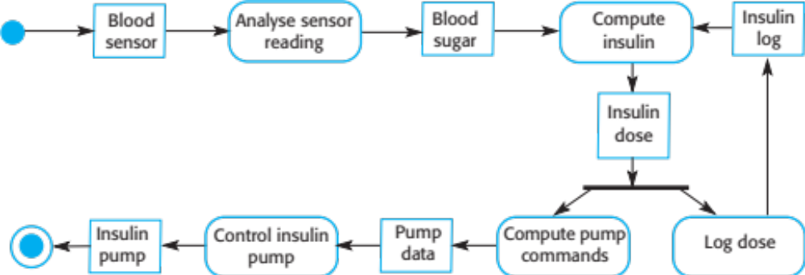
Activity model of the insulin pump

Slide 6
Essential high-level requirements
The system shall be available to deliver insulin when required.
The system shall perform reliably and deliver the correct amount of insulin to counteract the current level of blood sugar.
The system must therefore be designed and implemented to ensure that the system always meets these requirements.

Slide 7
Mentcare: A patient information system for mental health care
A patient information system to support mental health care is a medical information system that maintains information about patients suffering from mental health problems and the treatments that they have received.
Most mental health patients do not require dedicated hospital treatment but need to attend specialist clinics regularly where they can meet a doctor who has detailed knowledge of their problems.
To make it easier for patients to attend, these clinics are not just run in hospitals. They may also be held in local medical practices or community centres.

Slide 8
Mentcare
Mentcare is an information system that is intended for use in clinics.
It makes use of a centralized database of patient information but has also been designed to run on a PC, so that it may be accessed and used from sites that do not have secure network connectivity.
When the local systems have secure network access, they use patient information in the database but they can download and use local copies of patient records when they are disconnected.

Slide 9
Mentcare goals
To generate management information that allows health service managers to assess performance against local and government targets.
To provide medical staff with timely information to support the treatment of patients.

Slide 10
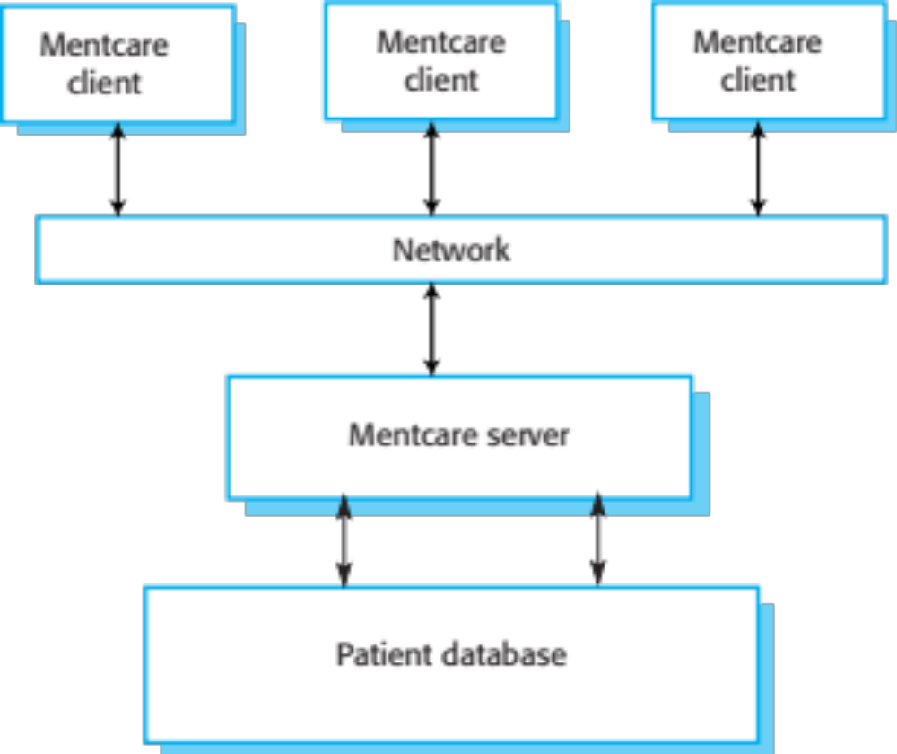
The organization of the Mentcare system

Slide 11
Key features of the Mentcare system
Individual care management
  Clinicians can create records for patients, edit the information in the system, view patient history, etc. The system supports data summaries so that doctors can quickly learn about the key problems and treatments that have been prescribed.
Patient monitoring
  The system monitors the records of patients that are involved in treatment and issues warnings if possible problems are detected.
Administrative reporting
  The system generates monthly management reports showing the number of patients treated at each clinic, the number of patients who have entered and left the care system, number of patients sectioned, the drugs prescribed and their costs, etc.

Slide 12
Mentcare system concerns
Privacy
  It is essential that patient information is confidential and is never disclosed to anyone apart from authorised medical staff and the patient themselves.
Safety
  Some mental illnesses cause patients to become suicidal or a danger to other people. Wherever possible, the system should warn medical staff about potentially suicidal or dangerous patients.
  The system must be available when needed otherwise safety may be compromised and it may be impossible to prescribe the correct medication to patients.

Slide 13
Wilderness weather station
The government of a country with large areas of wilderness decides to deploy several hundred weather stations in remote areas.
Weather stations collect data from a set of instruments that measure temperature and pressure, sunshine, rainfall, wind speed and wind direction.
  The weather station includes a number of instruments that measure weather parameters such as the wind speed and direction, the ground and air temperatures, the barometric pressure and the rainfall over a 24-hour period. Each of these instruments is controlled by a software system that takes parameter readings periodically and manages the data collected from the instruments.

Slide 14
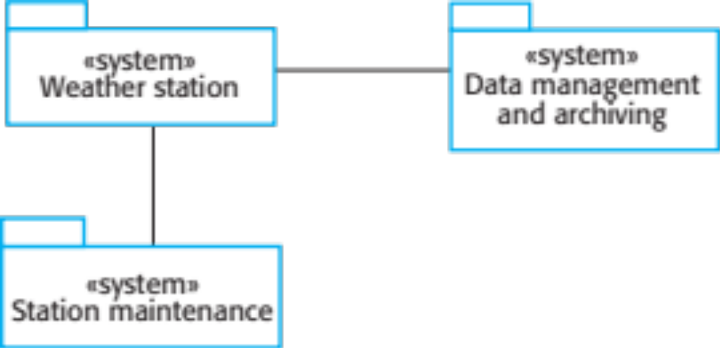
The weather station’s environment

Slide 15
Weather information system
The weather station system
  This is responsible for collecting weather data, carrying out some initial data processing and transmitting it to the data management system.
The data management and archiving system
  This system collects the data from all of the wilderness weather stations, carries out data processing and analysis and archives the data.
The station maintenance system
  This system can communicate by satellite with all wilderness weather stations to monitor the health of these systems and provide reports of problems.

Slide 16
Additional software functionality
Monitor the instruments, power and communication hardware and report faults to the management system.
Manage the system power, ensuring that batteries are charged whenever the environmental conditions permit but also that generators are shut down in potentially damaging weather conditions, such as high wind.
Support dynamic reconfiguration where parts of the software are replaced with new versions and where backup instruments are switched into the system in the event of system failure.

Slide 17
iLearn: A digital learning environment
A digital learning environment is a framework in which a set of general-purpose and specially designed tools for learning may be embedded plus a set of applications that are geared to the needs of the learners using the system.
The tools included in each version of the environment are chosen by teachers and learners to suit their specific needs.
  These can be general applications such as spreadsheets, learning management applications such as a Virtual Learning Environment (VLE) to manage homework submission and assessment, games and simulations.

Slide 18
Service-oriented systems
The system is a service-oriented system with all system components considered to be a replaceable service.
This allows the system to be updated incrementally as new services become available.
It also makes it possible to rapidly configure the system to create versions of the environment for different groups such as very young children who cannot read, senior students, etc.

Slide 19
iLearn services
Utility services that provide basic application-independent functionality and which may be used by other services in the system.
Application services that provide specific applications such as email, conferencing, photo sharing etc. and access to specific educational content such as scientific films or historical resources.
Configuration services that are used to adapt the environment with a specific set of application services and do define how services are shared between students, teachers and their parents.

Slide 20
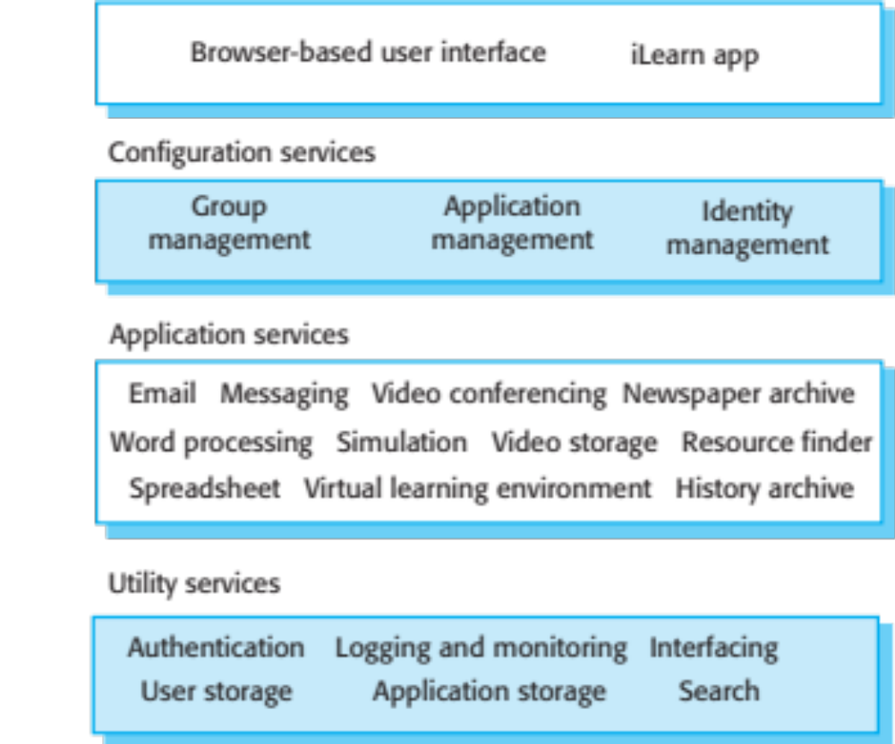
iLearn architecture

Slide 21
iLearn service integration
Integrated services are services which offer an API (application programming interface) and which can be accessed by other services through that API. Direct service-to-service communication is therefore possible.
Independent services are services which are simply accessed through a browser interface and which operate independently of other services. Information can only be shared with other services through explicit user actions such as copy and paste; re-authentication may be required for each independent service.

Slide 22
Key points
Software engineering is an engineering discipline that is concerned with all aspects of software production.
Essential software product attributes are maintainability, dependability and security, efficiency and acceptability.
The high-level activities of specification, development, validation and evolution are part of all software processes.
The fundamental notions of software engineering are universally applicable to all types of system development.

Slide 23
Key points
There are many different types of system and each requires appropriate software engineering tools and techniques for their development.
The fundamental ideas of software engineering are applicable to all types of software system.
Software engineers have responsibilities to the engineering profession and society. They should not simply be concerned with technical issues.
Professional societies publish codes of conduct which set out the standards of behaviour expected of their members.

